Slide 1
Advanced Data Correlation And Enrichment Using LSTM : Long Short – Term Memory
By Shriyansh Thote

Slide 2
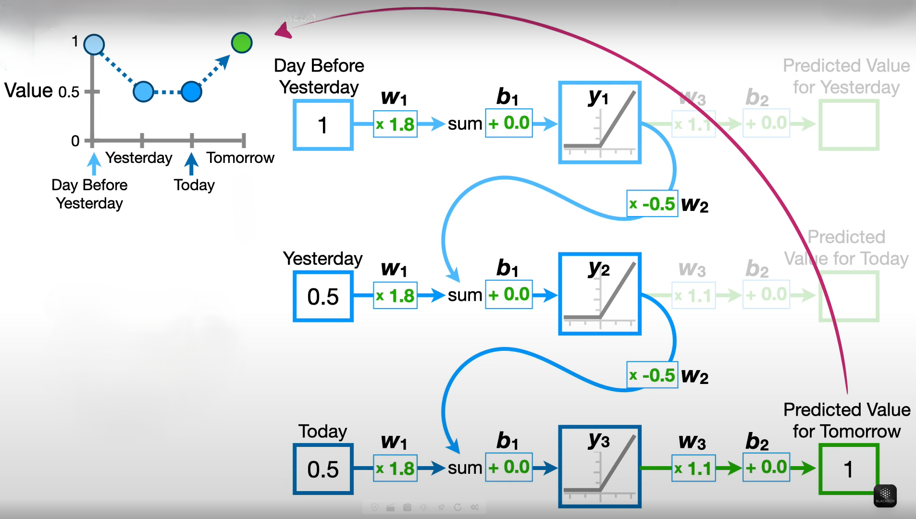
RNN: Recurrent Neural Network
RNN works on principle of saving the output layer and feeding this back to the input in order to predict the output of layer.
RNN works on sequential data.
Problems with RNN:
Exploding and vanishing gradient problems during backpropagation.
Gradients are those values which to update neural networks weights.
Vanishing gradient is a big problem in deep neural networks.
It vanishes or explodes quickly in earlier layers and this makes RNN unable to hold information of longer sequence. and thus RNN becomes short-term memory.
The problems in RNN can be solved using LSTM.

Slide 3
LSTM: Long Short – Term Memory
Long Short-Term Memory (LSTM) is an enhanced version of the Recurrent Neural Network (RNN) designed by Hochreiter & Schmidhuber.
LSTM is special type of RNN that handles exploding and vanishing gradient problems.
LSTM (Long Short-Term Memory) is a special type of recurrent neural network (RNN) designed to model sequential data and remember long-term dependencies. It's especially useful when past information (from earlier time steps) is critical for understanding the current output — such as in time series forecasting, speech recognition, or stock price prediction.
An LSTM cell contains:
Forget Gate: Decides what information to discard from the previous cell state.
Input Gate: Determines what new information to store in the cell state.
Cell State: The memory line that runs through the LSTM; regulated by gates.
Output Gate: Chooses what to output from the current cell state.

Slide 4
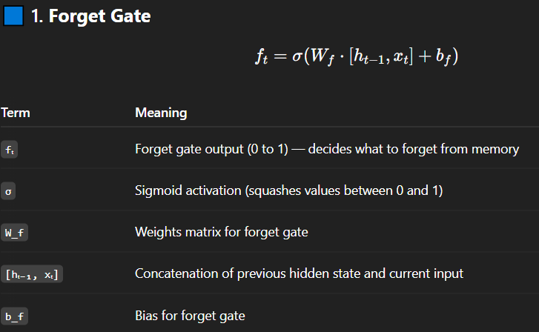
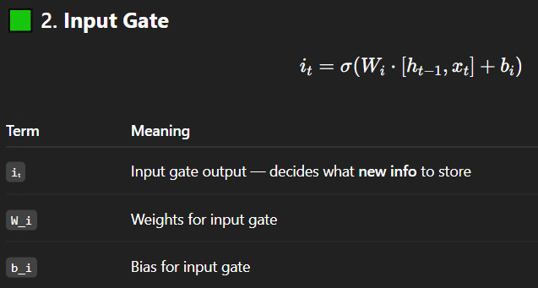
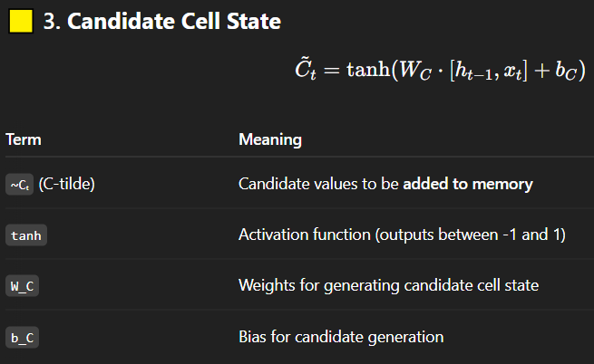
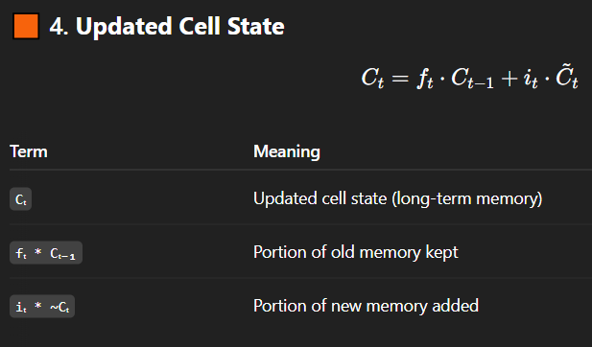
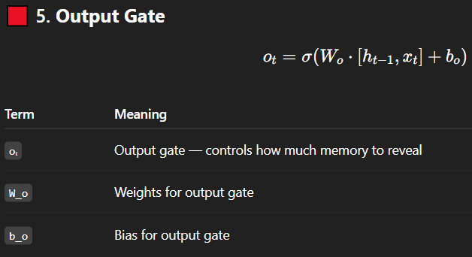
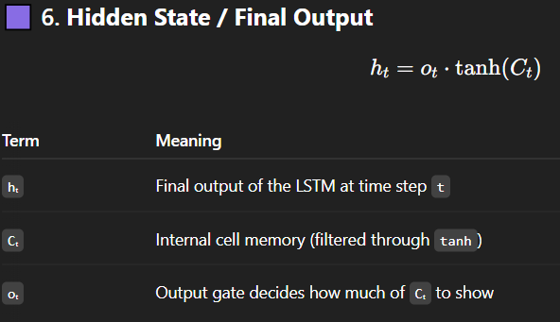

Slide 5
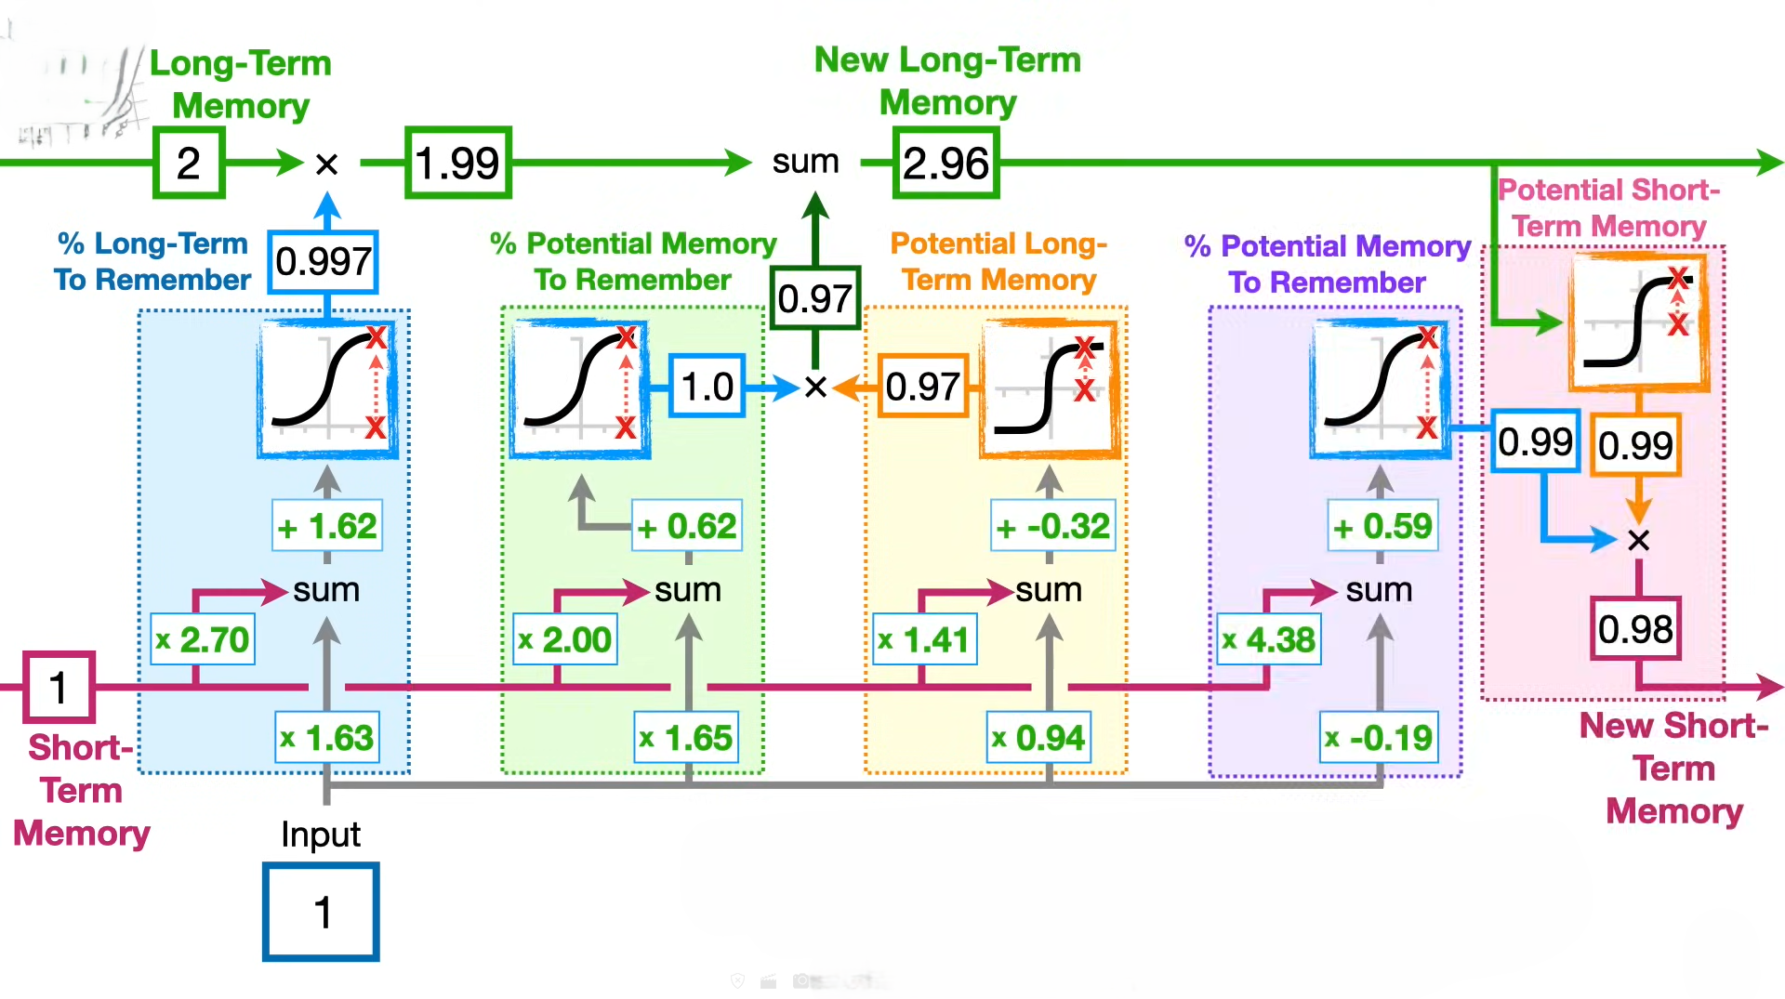

Slide 6
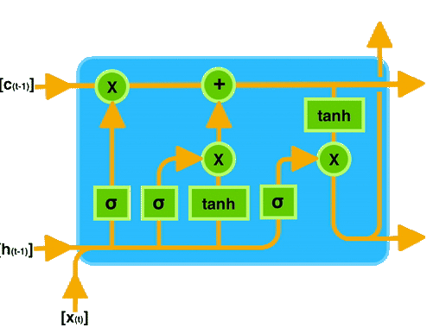

Slide 7
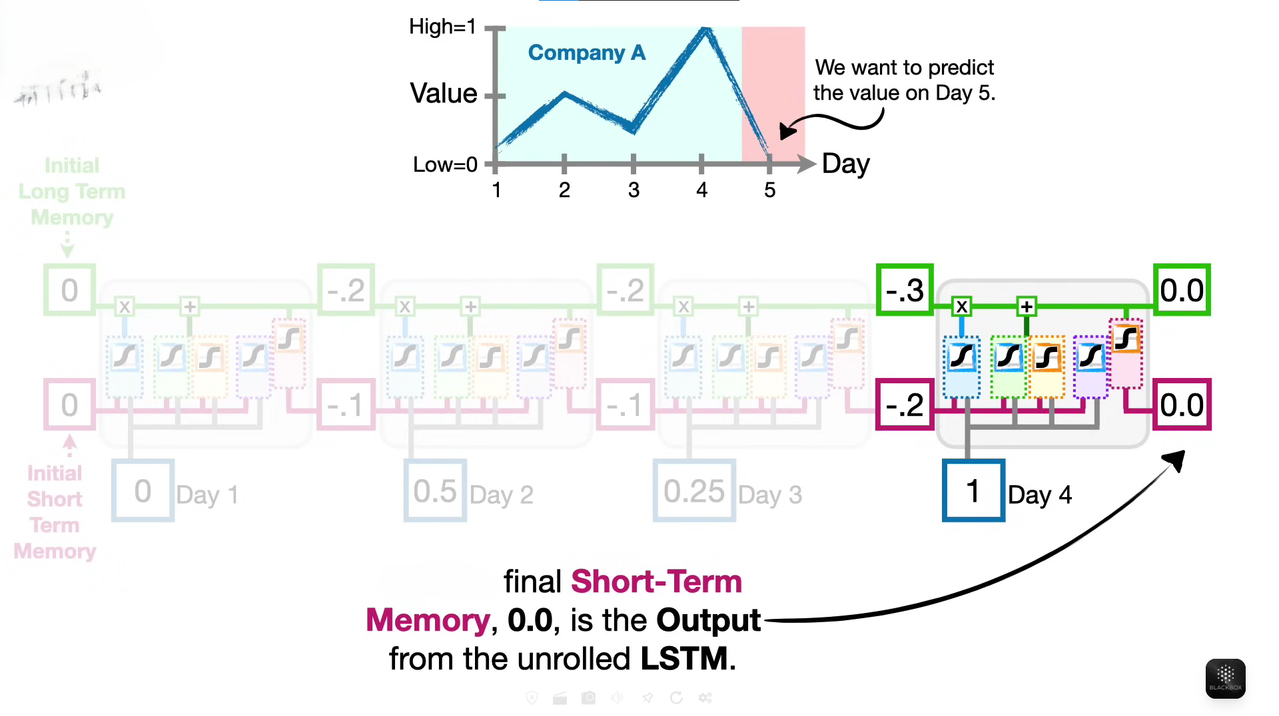

Slide 8
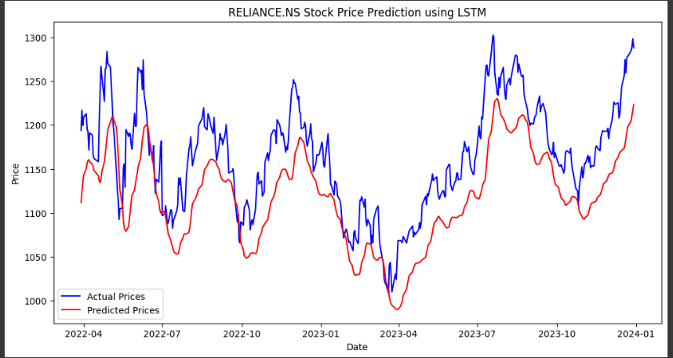
LSTM for Stock Price Prediction
In Simple LSTM, the data flows only forward — from the start of the sequence to the end.
LSTM for RELIANCE.NS Stock
The model shows 80 – 90 % accuracy.

Slide 9
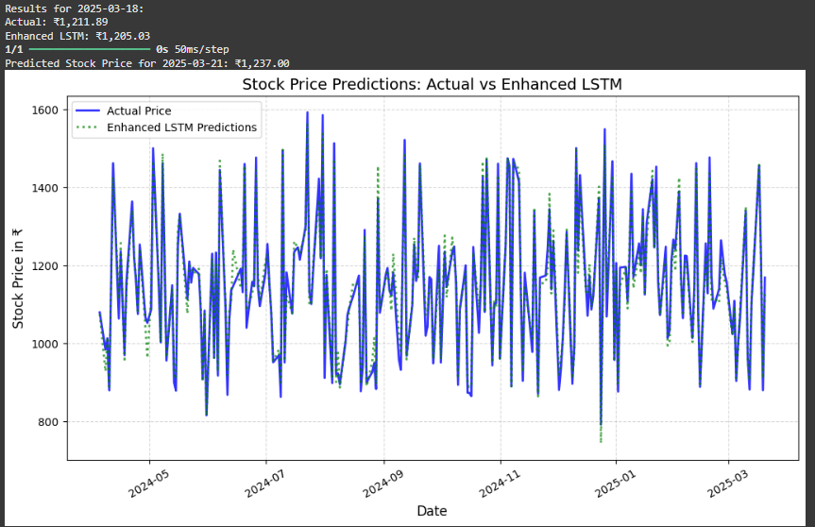
Enhanced LSTM
Enhanced LSTM means here bidirectional LSTM model.
It runs two LSTMs at the same time:
One reads the sequence forward (start → end).
One reads the sequence backward (end → start).
Their outputs are combined.
This way, the model knows past and future context at each point.
Enhanced LSTM Accuracy ≈ 99.43%
Mostly 90-99%

Slide 10
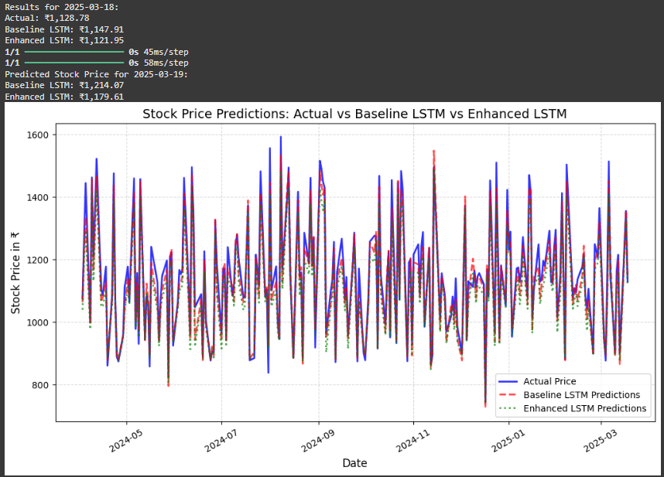
Actual Price vs Baseline LSTM vs Enhanced LSTM
Baseline LSTM here means simple LSTM model.
Enhanced LSTM here means Bidirectional LSTM model.
Model | Accuracy
Baseline LSTM | 98.31%
Enhanced LSTM | 99.40%

Slide 11
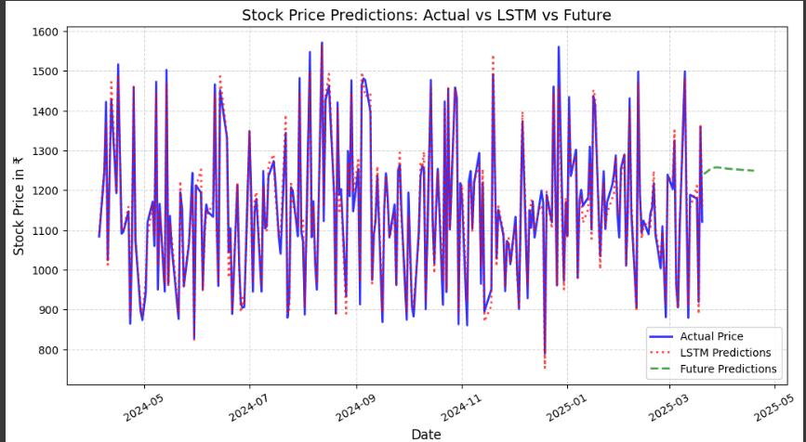
Future Trend in graph can also be predicted using LSTM. How in which direction the stock can move can be seen.

Slide 12
Objective: To evaluate the intrinsic worth and market position of various stocks using fundamental and technical indicators.
Approach:
Studied and applied technical indicators like:
P/E Ratio, P/B Ratio, ROE, EPS, Market Price, Volatility, Growth Rate
Implemented formulas programmatically to compute:
Intrinsic Value using multiple valuation models.
Yearly Average, Growth, and Volatility over historical data.
Compared calculated Intrinsic Values against current Market Price to derive:
Market-to-Intrinsic Ratio
Final Valuation Status (Overvalued, Undervalued, Fair Value)

Slide 13
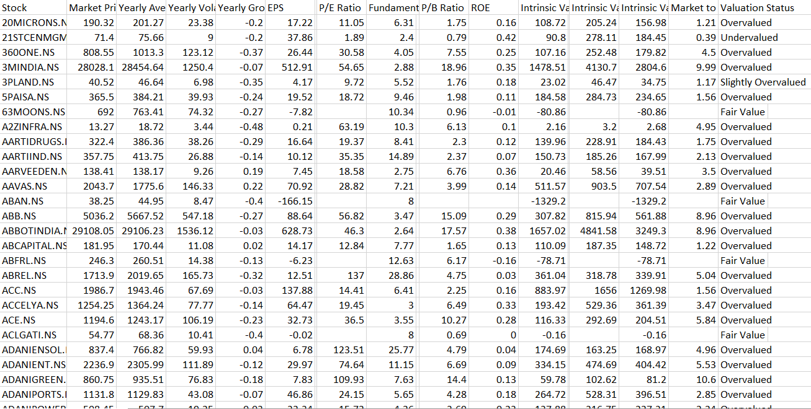

Slide 14
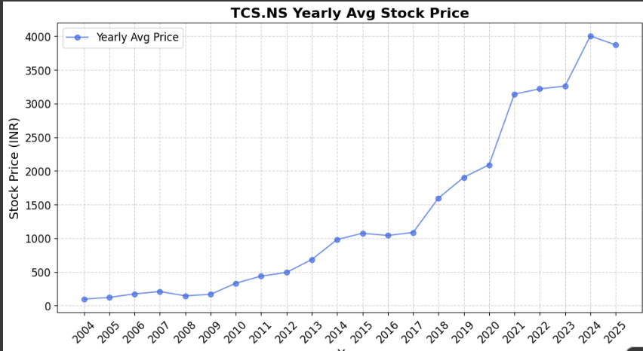
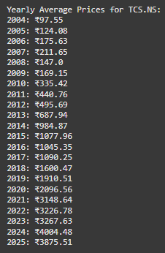
LSTM for Stock Data Analysis
LSTM can also be used to find Start of S-Curve point in stocks.
The point when a stock price begins its rapid growth phase after a period of slow or steady movement. Using concept of local minima found S-curve point.
S-Curve for TCS Step by Step:
Find Yearly Average Prices Since Listing Year and Plot graph representing data.

Slide 15
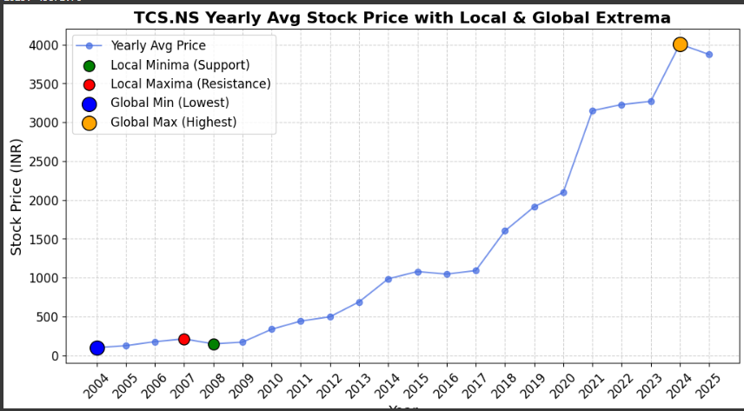
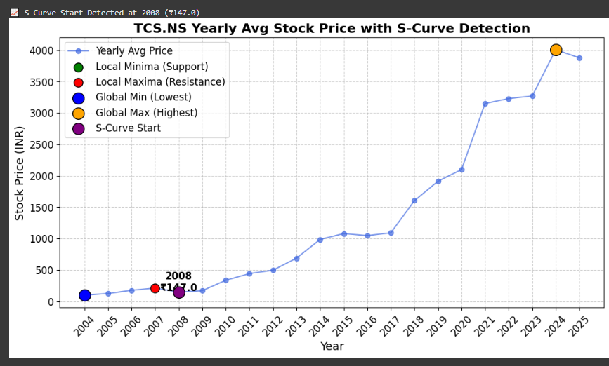
Identified Local Maxima(Resistance) and
Local Minima(Support) Points
If local minima is followed by a 10% rise next year and for next three years it continue to rise that point was identified as S-curve start point/year.
In case of TCS.NS the S-curve was identified in year 2008 for Yearly Avg. Price Rs. 147.0

Slide 16
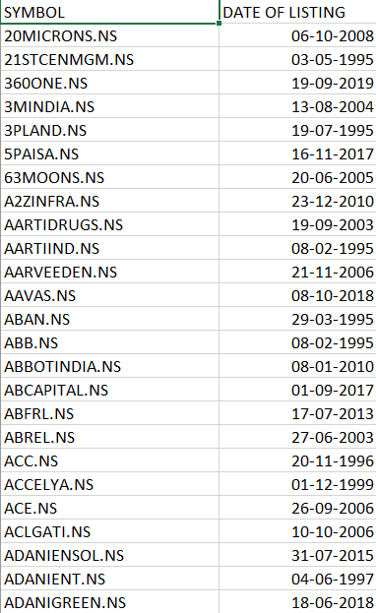
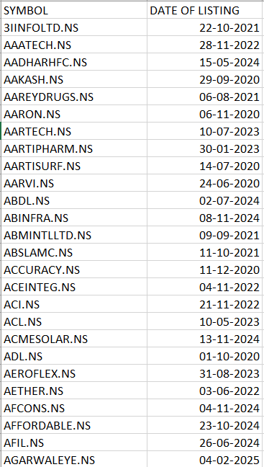
Task Overview:
Objective:
Find the S-Curve Start for companies listed before 2020.
Train an LSTM model on this historical data.
Use the trained model to predict S-Curve Start for companies listed after 2020.
Methodology:
Data Preparation:
Separated stocks into two groups:
Pre-2020 listed companies (for training)
Post-2020 listed companies (for prediction)

Slide 17
Problems faced:
Data Collection Strategy:
Initially, I used the `yfinance` Python library to collect historical stock data starting from the listing date.
However, one major limitation of yfinance is that it does not provide the IPO/listing year directly.
As a result, it sometimes includes pre-IPO or historical backfilled data, which can negatively impact model accuracy.
Solution Implemented:
To address this issue:
I used the NSE (National Stock Exchange) website to obtain the official listing (IPO) dates of each stock.
I then created a filtered stock list with correct IPO dates.
Finally, I used `yfinance` again, but this time to download data starting only from the verified IPO date for each stock.

Slide 18
LSTM Model Workflow: From Data to Prediction
1. Data Collection
- Collected stock price data using `yfinance`.
- Verified IPO/listing dates using NSE website to avoid pre-IPO data.
- Gathered yearly average prices and additional features (e.g., volatility, sector).
2. Data Cleaning & Preparation
- Removed missing values or outliers.
- Ensured all stocks have enough historical years (e.g., ≥ 5 years).
3. Normalization
- Applied MinMaxScaler to scale features between 0 and 1.
- Normalization was done stock-by-stock to preserve internal trends.
4. Sequence Creation
- Used sliding windows to create sequences (e.g., 5-year chunks).
- Each sequence represents a short history of a stock.
5. Input Shape for Model
- Input data formatted as:
(samples, timesteps, features) e.g., (3000, 5, 4)
- Each sample is a 5-year sequence of stock features.

Slide 19
6. Model Architecture
- Two LSTM layers to extract temporal patterns.
- Dropout layers to prevent overfitting.
- Two Dense heads:
- `price_output`: Predicts S-Curve Start Price
- `year_output`: Predicts Years to S-Curve Start
7. Model Compilation
- Loss: Mean Squared Error (MSE) for both outputs.
- Metrics: Mean Absolute Error (MAE).
8. Model Training
- Trained using pre-2020 stock data with known S-Curve points.
- Used `model.fit()` with proper batch size and epochs.
9. Prediction Phase
- Used post-2020 stock sequences as input.
- Model predicted:
- When the S-Curve is likely to begin.
- What the price might be at that point.
10. Result Analysis
- Compared predicted values to real trends.
- Performed sector-wise grouping for further insight.

Slide 20
Method 1 : S-Curve Start Detection
Applied the concept of maxima and minima to historical stock price data.
Specifically focused on identifying local minima — points where the stock price was lower than its immediate neighbors, indicating a potential bottom.
From each local minimum, we checked for a price increase of at least 10% in the following period.
If this condition was met, that point was marked as the S-Curve Start, signaling the beginning of a significant upward trend.
These identified S-Curve Start points were labeled for all pre-2020 companies, forming the training dataset for the LSTM model.
Model Training:
Trained an LSTM model using the labeled pre-2020 data.
The model learned patterns leading up to the S-Curve Start.
Prediction Phase:
Provided post-2020 stock data to the trained LSTM model.
The model predicted the S-Curve Start points for post-2020 companies.

Slide 21
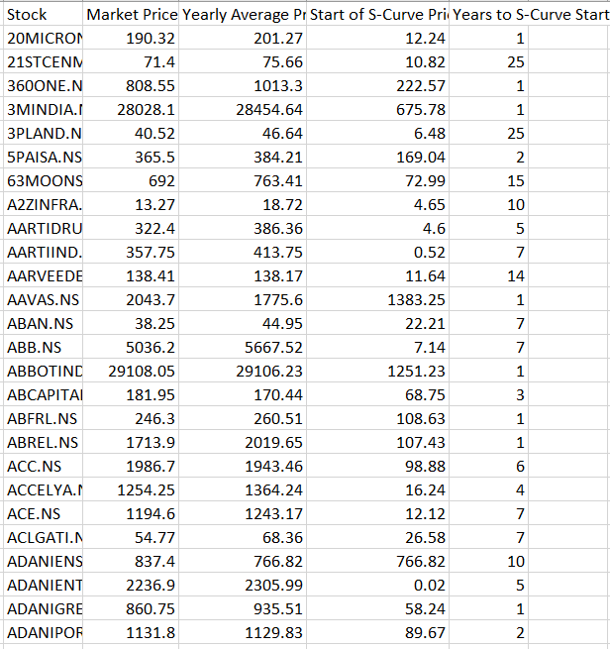
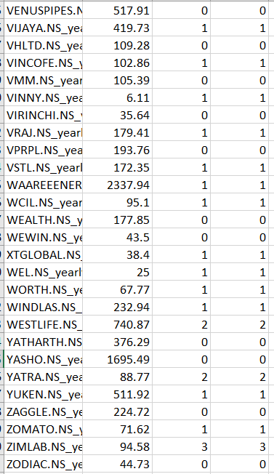
Pre-2020 Stocks
Post-2020 Stocks
The values showed too much variation like either too low or too high.
Mostly the predicted values were 0, 1. or similar regardless of actual expected range.

Slide 22
Method 2: Global Minima-Based S-Curve Start Detection
Analyzed historical stock price data using the concepts of maxima and minima.
For each stock, the global minimum(the lowest price point after listing) was identified.
Special care was taken to ensure the global minimum was not the listing price itself, since in some cases, the stock lists at its lowest price.
To address this, the lowest price greater than the listing price was selected as the global minimum.
If the global minimum was followed by a significant upward trend, this point was marked as the S-Curve Start.
These S-Curve Start points were then labeled for all pre-2020 companies, creating the training dataset for the LSTM model.
Model Training:
Trained an LSTM model using the labeled pre-2020 data.
The model learned patterns leading up to the S-Curve Start.
Prediction Phase:
Provided post-2020 stock data to the trained LSTM model.
The model predicted the S-Curve Start points for post-2020 companies.

Slide 23
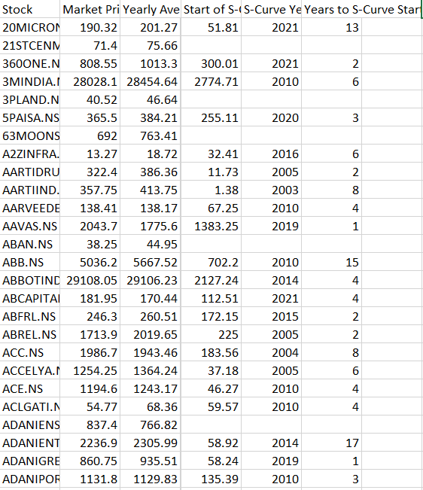
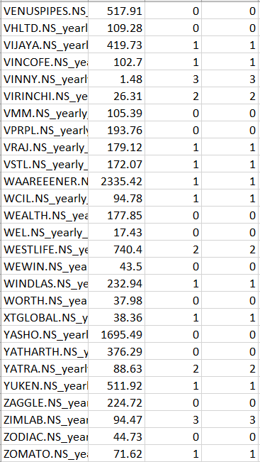
Pre-2020 Stocks
Post-2020 Stocks
The values somewhat stabilized but not as expected.
Still similar results mostly 0, 1 or similar.

Slide 24
Method 3: Year-on-Year Percentage Growth Analysis
Calculated yearly average prices for each stock based on historical data.
Determined the percentage change in average price from the previous year.
Analyzed the data using a **5-year rolling window** to identify sustained growth trends.
Growth within a window was considered sustained if:
The average growth rate across the 5 years was ≥ 15%.
At least 60% of the years within the window showed significant positive growth.
The first year in the window meeting these criteria was labeled as the S-Curve Start.
These identified points were used to label pre-2020 companies, forming part of the training dataset for the LSTM prediction model.
Model Training:
Trained an LSTM model using the labeled pre-2020 data.
The model learned patterns leading up to the S-Curve Start.
Prediction Phase:
Provided post-2020 stock data to the trained LSTM model.
The model predicted the S-Curve Start points for post-2020 companies.

Slide 25
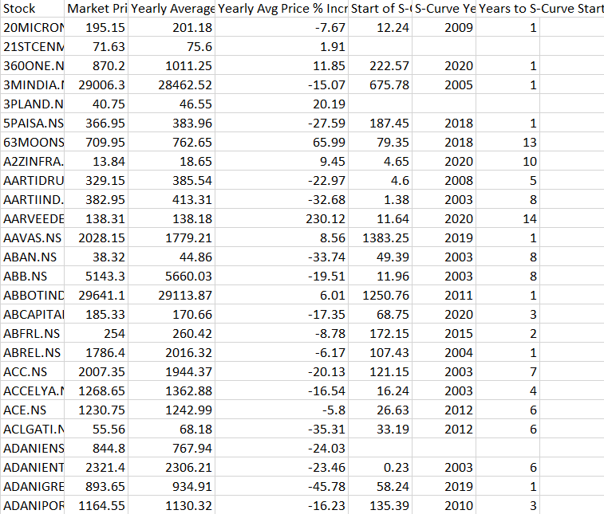
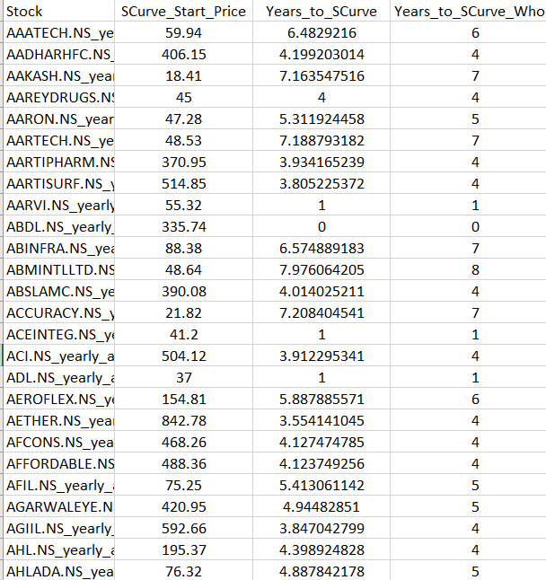
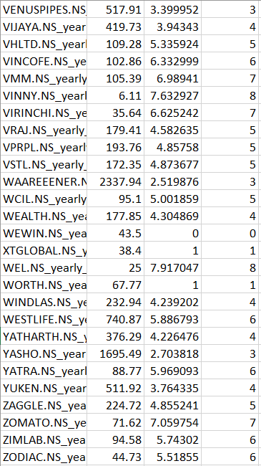
Pre-2020 Stocks
Post-2020 Stocks
The values showed significant variation as expected.
The predicted values also shows a wide range which is expected.

Slide 26
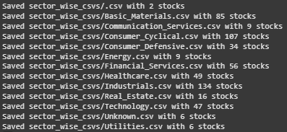
Now we have data of s-curve for stocks
Stock (like TCS.NS, INFY.NS, etc.)
S-Curve Start Price
Years to S-Curve
Identified the sector of each stock using yfinace and created new column in dataset “Sector”
Based on Sector separated all stocks.
Example sectors: Technology, Financial Services, Healthcare, etc.
Note:
While retrieving sector information using yfinance, some stocks did not have sector data available in the API. For those cases, the sector has been labeled as "Unknown". These stocks are grouped under the "Unknown" category in the sector-wise classification for completeness.

Slide 27
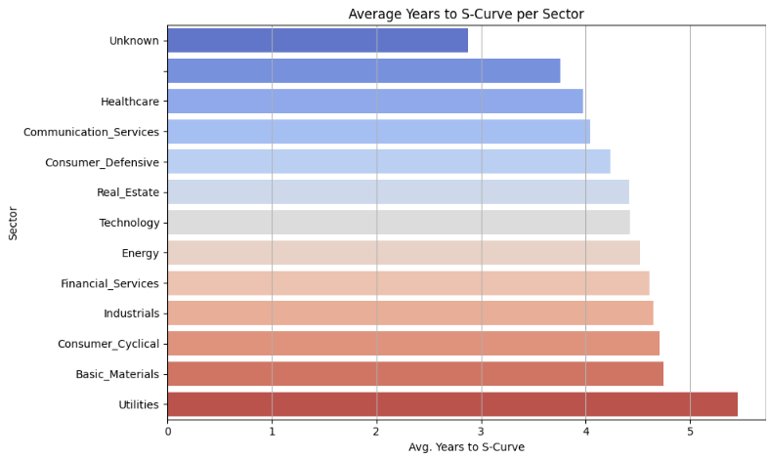
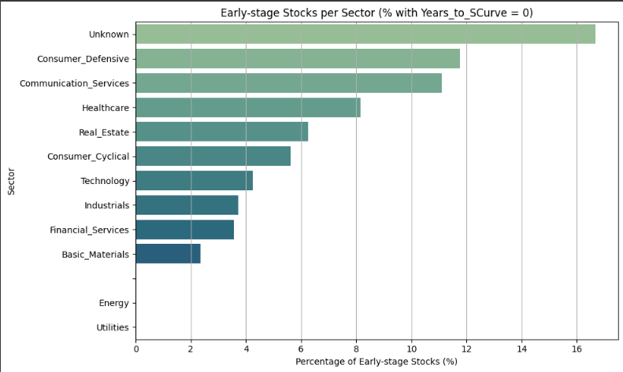
Sector Analysis Ideas
Idea | What It Means
Plot Sector-Wise Average S-Curve | Visualize maturity across sectors
Detect Early-Stage Sectors | Sectors where many stocks have Years_to_SCurve = 0
Identify Mature vs. Emerging Sectors | Based on S-curve development patterns

Slide 28
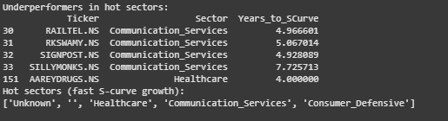
Hot Sector & Underperformer Identification
Found hot sectors (lowest average Years_to_SCurve).
Within hot sectors, find underperformers (stocks lagging their peers).

Slide 29
Future Plans:
Industry Wise Analysis.
Use technical indicators for deeper analysis.
Deep down analysis of each sector.
How Global Markets affect Indian Markets.
And many more…

Slide 30
Thank You!

